Slide 1
PG-DAI (C-DAC, ACTS Pune) Team : Group 4
Topic: - Social Media Comment Analyzer
Project Guide: Dr. Krishnanjan B.
Team Members:
Manali Singh (220340128022) Shraddha Bhide (220340128004) Vishal Joshi (220340128014) Shubham Narad (220340128030) Gaurav Pol (220340128011)

Slide 2
Contents
S.No. | Topic | Presented By
1 | Objective | Manali Singh
2 | Introduction | Manali Singh
3 | Dataset | Vishal Joshi
4 | Data Preprocessing & EDA | Vishal Joshi
5 | Model: LSTM and Bidirectional LSTM | Gaurav Pol
6 | Model : DistilBert | Shubham Narad
7 | Deployment | Shraddha Bhide
8 | Conclusion | Shraddha Bhide

Slide 3
Objective
Analyze comments put on social media such as YouTube, Twitter, Orkut, etc and;
To classify textual content whether hate speech comments are dangerous or non dangerous (to the society),

Slide 4
Introduction
As online content continues to grow, so does the spread of hate speech. We have identified and examined challenges faced by online automatic approaches for hate speech detection in text.
Hate crimes are unfortunately nothing new in society. However, social media and other means of online communication have begun playing a larger role in hate crimes.
Among these difficulties are subtleties in language, differing definitions on what constitutes hate speech, and limitations of data availability for training and testing of these systems.

Slide 5
Detecting hate speech is a challenging task, however. First, there are disagreements in how hate speech should be defined. This means that some content can be considered hate speech to some and not to others, based on their respective definitions.
We start by covering competing definitions, focusing on the different aspects that contribute to hate speech. We are by no means, nor can we be, comprehensive as new definitions appear regularly. Our aim is simply to illustrate variances highlighting difficulties that arise from such.

Slide 6
Natural Language Processing(NLP) has been around a few decades now and can be used to gain a greater understanding of the text, such as the structure of the text and meaning at several levels that include document, paragraph, and sentence.
NLP allows individual to define classes inside language, how the terms refer to one another perhaps one of the most challenging activities — toxicity analysis (Mohammad n.d.)

Slide 7
Dataset, EDA
Dataset (Key Columns):
Hate Speech score - continuous hate speech measure, where higher = more hateful and lower = less hateful
text - lightly processed text of a social media post
Comment id - unique ID for each comment
Annotator id - unique ID for each annotator
Sentiment, Respect, Insult, Humiliate, Status, dehumanize, violence, genocide, attack_defend, hatespeech - ordinal label that is combined into the continuous score
annotator_severity - annotator's estimated survey interpretation bias

Slide 8
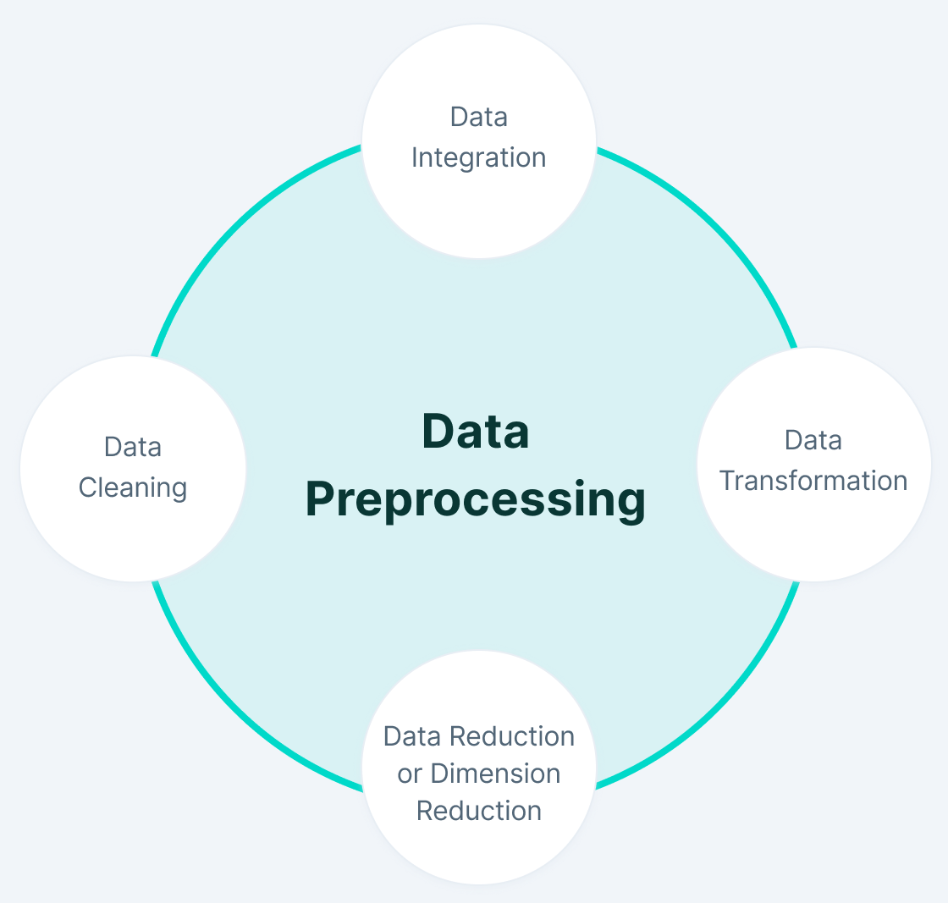
Data Preprocessing:
It helps in transforming the raw data into a clean data set that excludes noise and thus gives better results.
(eg. Action we performed)

Slide 9
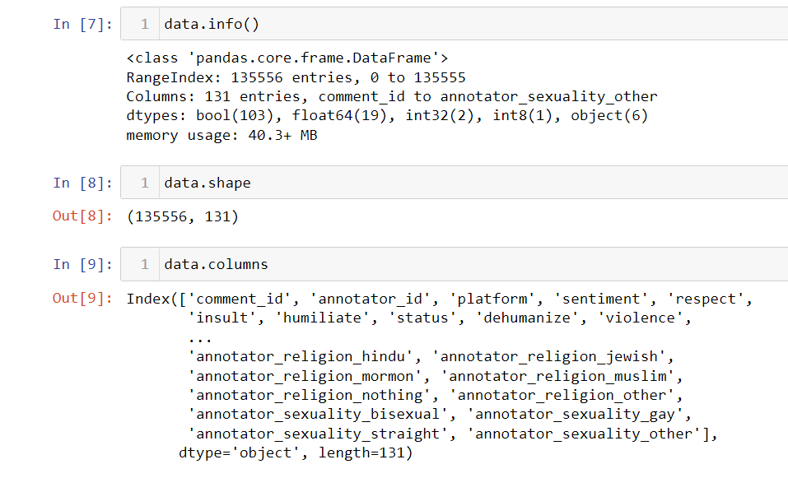

Slide 10
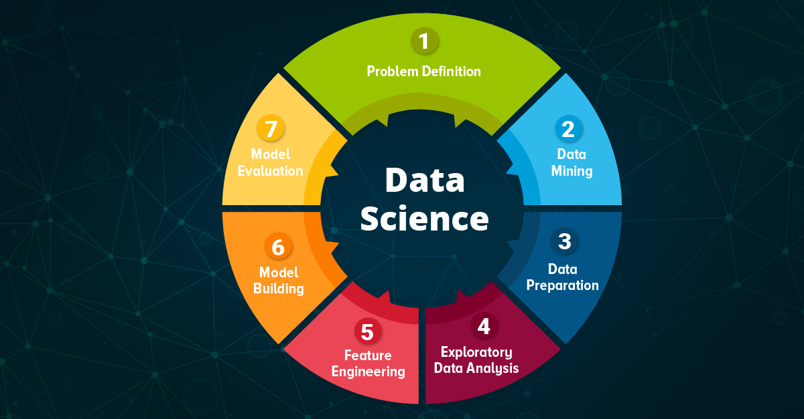
EDA:
Exploratory Data Analysis (EDA) is an approach/philosophy for data analysis that employs a variety of techniques (mostly graphical) to maximize insight into a data set:
uncover underlying structure;
extract important variables;
detect outliers and anomalies;
test underlying assumptions;
develop parsimonious models; and
determine optimal factor settings.
Eg.Action performed

Slide 11
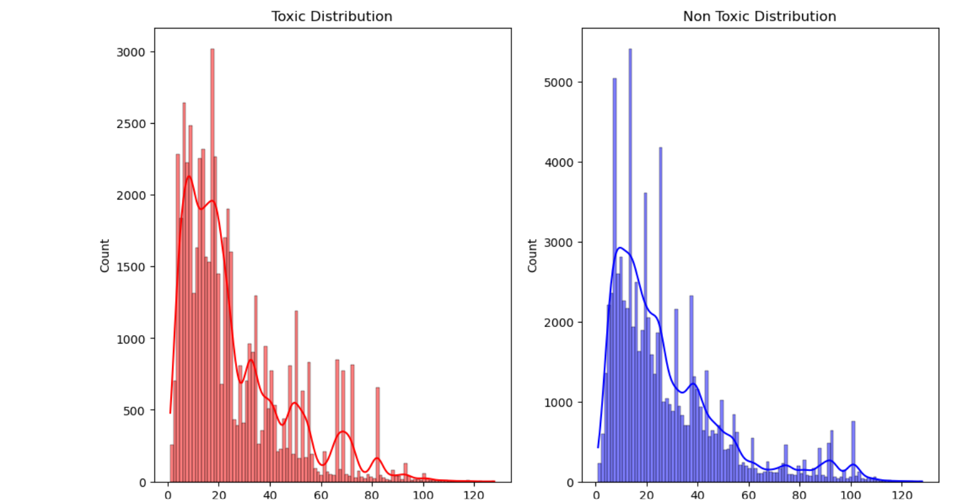

Slide 12
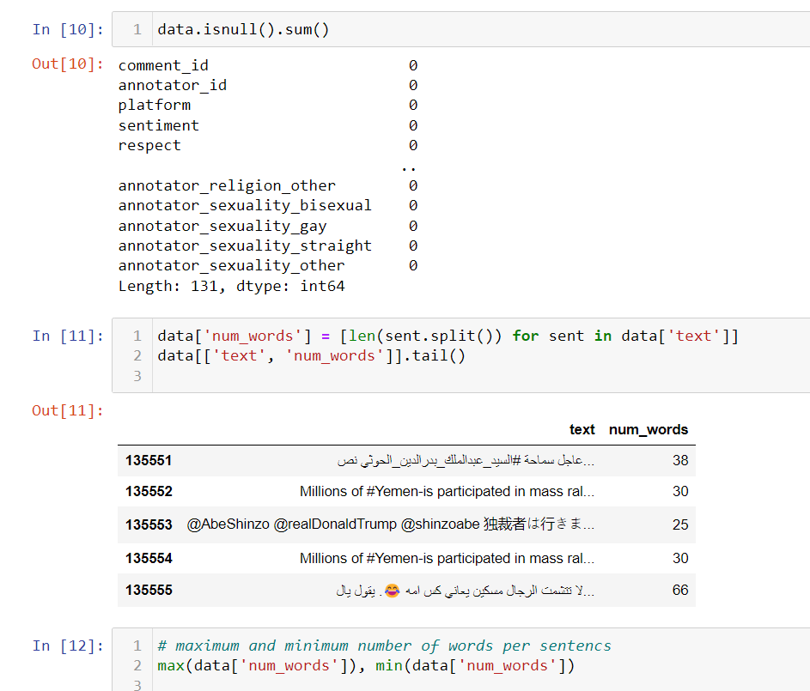

Slide 13
Model: LSTM
Long short-term memory(LSTM):
LSTM networks are RNN extensions designed to learn sequential (temporal) data and their long-term connections more precisely than standard RNNs. They are commonly used in deep learning applications such as stock forecasting, speech recognition, natural language processing, etc.
LSTM networks are indeed an improvement over RNNs as they can achieve whatever RNNs might achieve with much better finesse. As intimidating as it can be, LSTMs do provide better results
LSTM has 3 main gates:
FORGET Gate
INPUT Gate
OUTPUT Gate

Slide 14
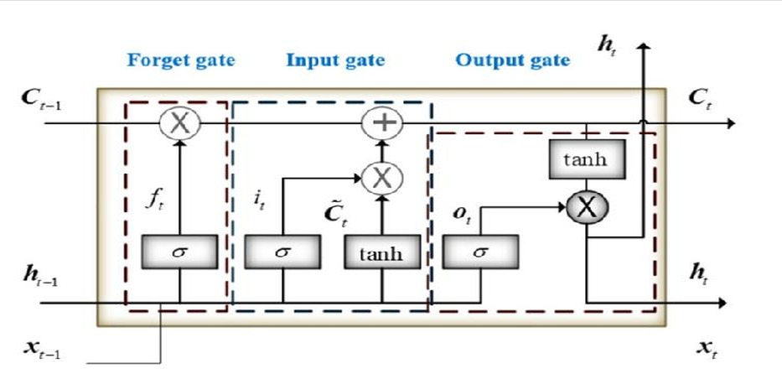

Slide 15
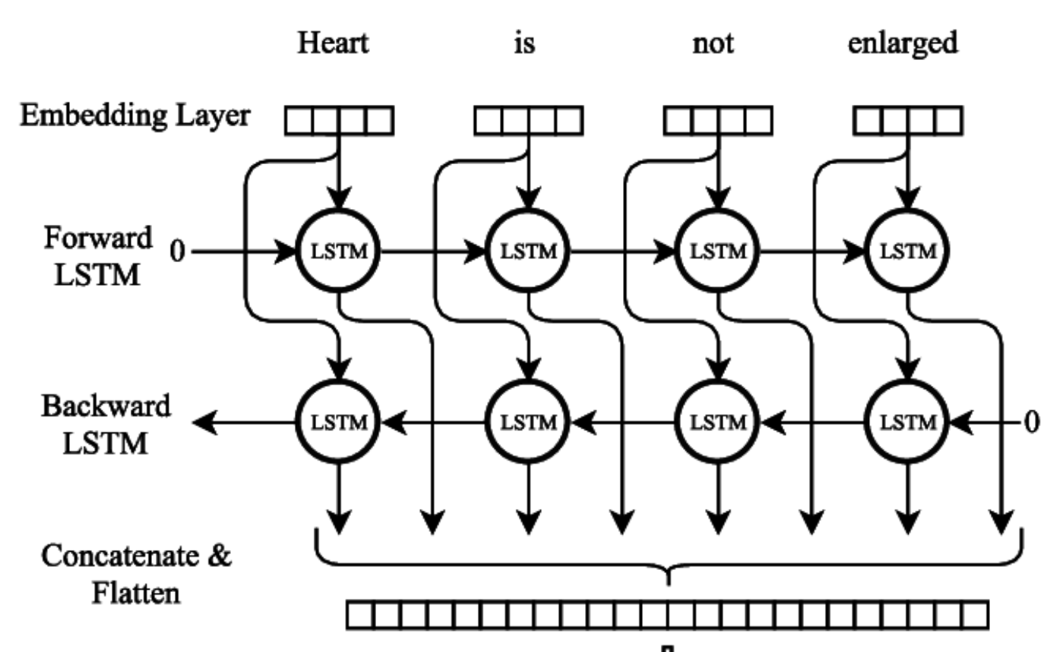
Model: Bidirectional LSTM
Bidirectional recurrent neural networks connect two hidden layers of opposite directions to the same output. With this form of generative deep learning, the output layer can get information from past and future states simultaneously

Slide 16
In bidirectional LSTM we give the input from both the directions from right to left and from left to right.
In normal LSTM network we take output but in bidirectional LSTM network output of forward and backward layer at each stage is given to activation layer which is a neural network and output of this activation layer is considered. This output contains the information or relation of past and future word also.
Bidirectional LSTM has an accuracy of 31.99%

Slide 17
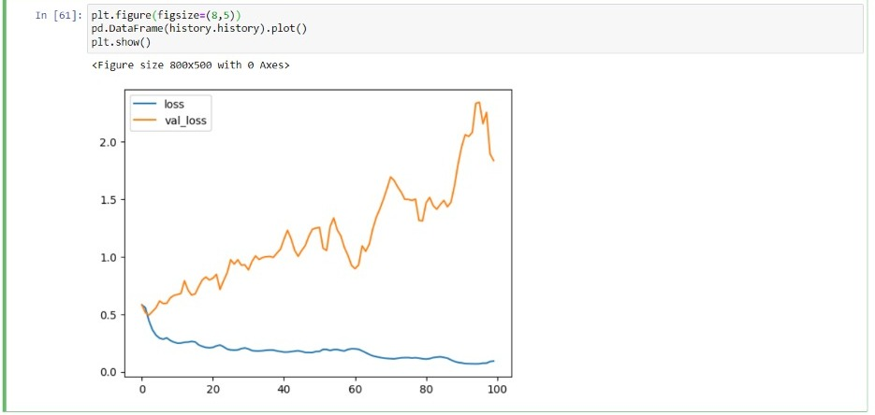

Slide 18
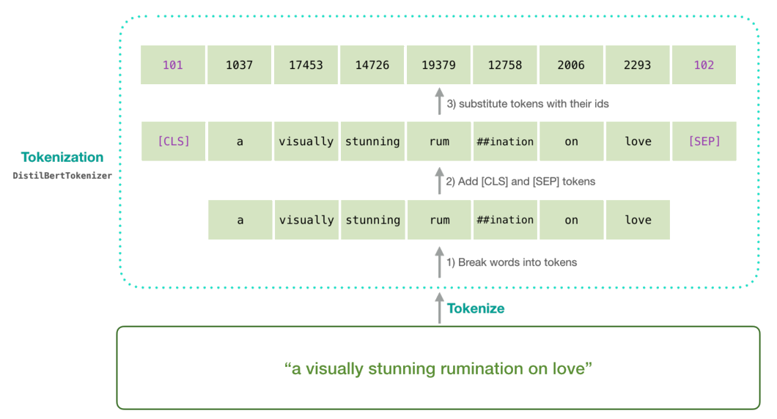
Model : DistilBert
It is the process of training a small student model to mimic a larger teacher model as close as possible.

Slide 19
DistilBERT is a small, fast, cheap and light Transformer model based on the BERT architecture. Knowledge distillation is performed during the pre-training phase to reduce the size of a BERT model by 40%.
DistilBERT has two steps:
1. Copying the Teacher’s architecture
2. Distillation Loss

Slide 20
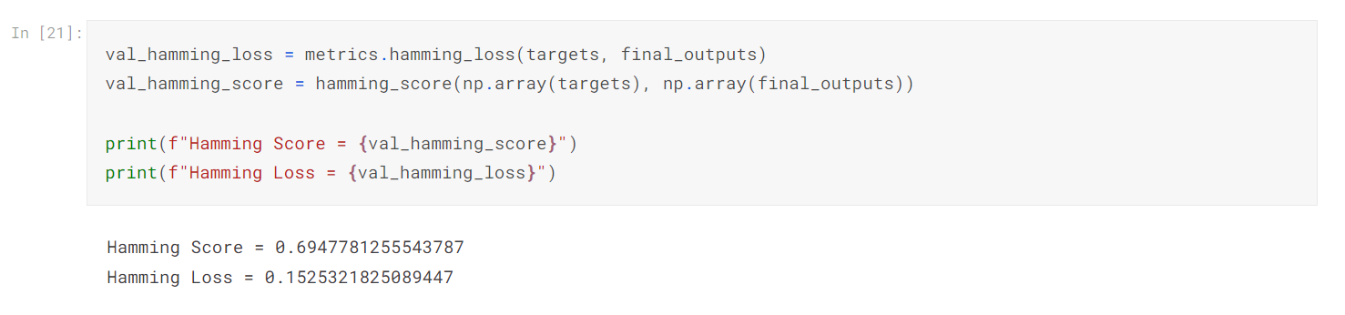

Slide 21
Deployment
The social media comment analyzer project has been deployed on Streamlit
We have prepared the web app to take a YouTube video as input
The output will be comments and their binary rating under each column specified in the dataset

Slide 22
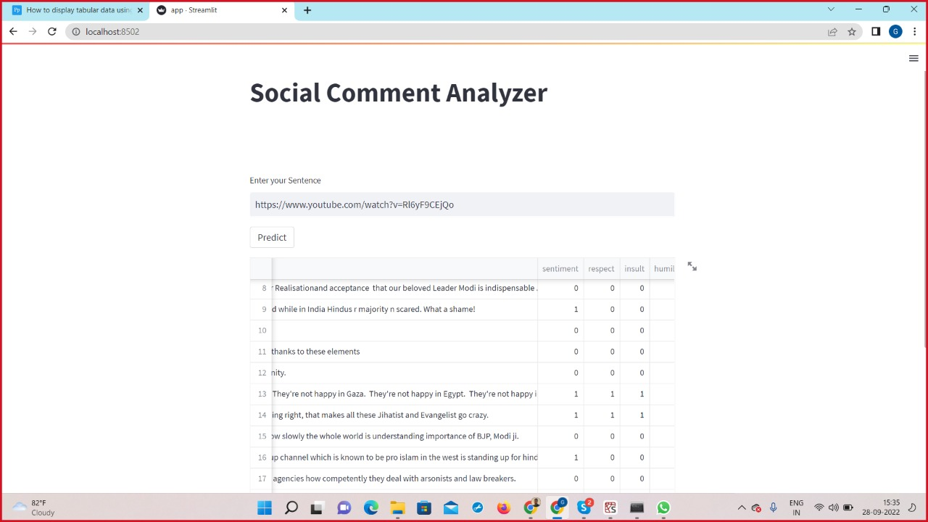

Slide 23
Future Work
The project model can be made on the BERT (Bidirectional Encoder Representations from Transformers,)
Instead of one platform (we have taken YouTube), other platforms such as twitter, Instagram can also be studied by this model
The deployment can be done on streaming data
Also instead of one YouTube video, more than one video/channels can be taken as input and;
The video with most toxic or dangerous comments can be flagged.

Slide 24
Thank You!!

